Slide 1
Project Title:
Project Phase-1 CIE Presentation of the 6th semester AY: 2026-27
Presented By
Nandan Kuchabal (1NT23EC090)
Sagar A S (1NT23EC134)
Relangi Mahesh Satya Venkat Gowd (1NT23EC127)
Project Supervisor
Prof Amruth Ashok Gadag
Assistant Professor
Dept. of Electronics and Communication Engineering
Nitte Meenakshi Institute of Technology, Yelahanka, Bangalore-560064

Slide 2
Presentation Outline
Problem definition
Literature Survey
Research Gap Analysis
Project Objectives
Architecture/block diagram (Prototype Level)
Functional requirements implemented in prototype
Results and Analysis
Conclusion and Future Scope
References

Slide 3
Problem definition
ASR performance decreases in far-field environments.
Background noise and reverberation affect speech clarity.
Existing systems mainly focus on close-talk speech.
Limited robust ASR systems for regional languages.
Real-world environments require distant speech processing.
Beamforming can improve speech quality and recognition accuracy.

Slide 4
Literature Survey
W. He, L. Lu, B. Zhang, J. Kalgaonkar and C. Fuegen, “Spatial Attention for Far-Field Speech Recognition with Deep Beamforming Neural Networks”, ICASSP, 2020.
Proposed a deep learning-based beamforming approach for far-field ASR.
Used spatial attention mechanisms to enhance target speech signals.
Improved speech recognition performance in noisy environments.
Combined beamforming with neural network-based speech enhancement.
Requires large datasets and high computational resources.
W. Zhang, A. S. Subramanian, X. Chang, S. Watanabe and Y. Qian, “End-to-End Far-Field Speech Recognition with Unified Dereverberation and Beamforming”, Interspeech, 2020.
Integrated dereverberation and beamforming into a single ASR framework.
Improved recognition accuracy in reverberant far-field environments.
Used end-to-end optimization for speech enhancement and recognition.
Demonstrated robustness against environmental distortions.
Computational complexity remains a major challenge.

Slide 5
Literature Survey
K. Kumatani, M. Wu, S. Sundaram, N. Strom and B. Hoffmeister, “Multi-Geometry Spatial Acoustic Modeling for Distant Speech Recognition”, ICASSP, 2019.
Focused on distant speech recognition using multiple microphone geometries.
Improved spatial acoustic modeling for far-field environments.
Demonstrated the importance of microphone placement.
Enhanced speech recognition performance in noisy conditions.
Requires careful calibration and environment-specific tuning.
D. Wang, Z. Chen and T. Yoshioka, “Neural Speech Separation Using Spatially Distributed Microphones”, IEEE/ACM Transactions on Audio, Speech and Language Processing, 2020.
Proposed neural network-based speech separation using multiple microphones.
Reduced interference from surrounding speakers and background noise.
Improved recognition accuracy in multi-speaker environments.
Combined spatial filtering with deep learning methods.
Performance depends heavily on training data diversity.

Slide 6
Literature Survey
T. Yoshioka and M. Delcroix, “Neural Network Based Beamforming for Far-Field Speech Recognition”, IEEE Signal Processing Letters, 2017.
Introduced neural-network-based beamforming techniques.
Improved speech enhancement for distant speech signals.
Combined adaptive beamforming with ASR systems.
More flexible than traditional beamforming methods.
Increased computational requirements for real-time processing.
J. Chen, J. Benesty and Y. Huang, “Microphone Array Signal Processing for Speech Enhancement”, IEEE Signal Processing Magazine, 2006.
Discussed microphone-array-based speech enhancement methods.
Explained spatial filtering and noise suppression techniques.
Demonstrated the effectiveness of beamforming in noisy environments.
Improved speech clarity for far-field communication systems.
Performance decreases in highly dynamic noise conditions.

Slide 7
Research Gap Analysis
Literature survey shows that most far-field ASR systems are mainly developed for English and other high-resource languages.
Existing works focus on advanced neural beamforming techniques that require high computational resources and large training datasets.
Many beamforming approaches are tested only in controlled environments and show limited robustness in real-world noisy conditions.
Current research mainly emphasizes speech enhancement rather than regional-language far-field speech recognition applications.
Integration of beamforming techniques with regional-language ASR systems is still limited.

Slide 8
Project Objectives
The following are the proposed objectives of the project based on the research gaps:
To design and develop a far-field speech recognition system for a selected regional language using beamforming-based speech enhancement.
To implement and analyze beamforming techniques for improving speech quality in noisy and reverberant environments.
To evaluate the performance of the proposed system by comparing speech recognition results before and after beamforming.

Slide 9
Functional requirements for prototype
Req ID | Functional Requirement | Expected Outcome
FR1 | The system shall acquire far-field speech input through recorded audio samples. | Speech input is accepted for processing.
FR2 | The system shall apply Delay-and-Sum beamforming for speech enhancement. | Background noise and interference are reduced.
FR3 | The system shall convert enhanced speech into text using ASR. | Recognized text output is generated.
FR4 | The system shall compare speech recognition before and after enhancement. | Performance improvement is analyzed.

Slide 10
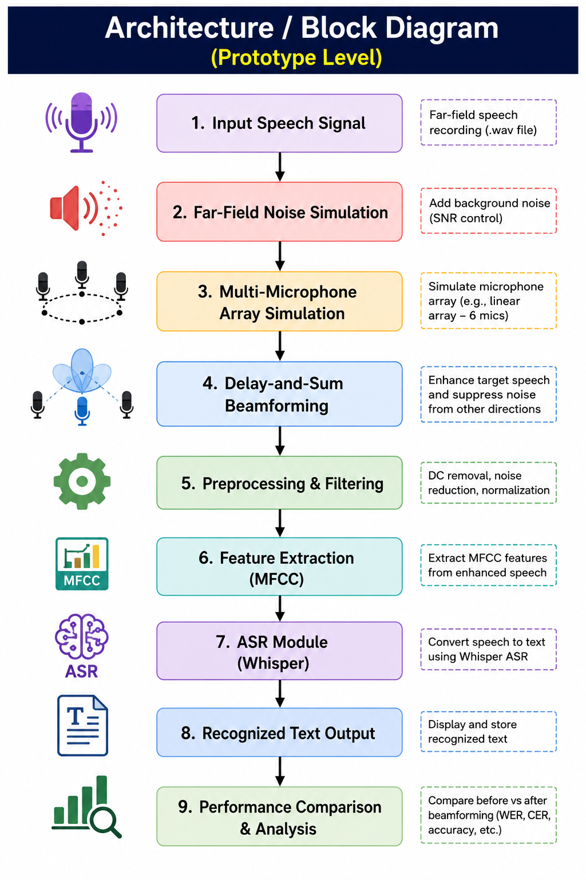
Architecture/block diagram (Prototype Level)

Slide 11
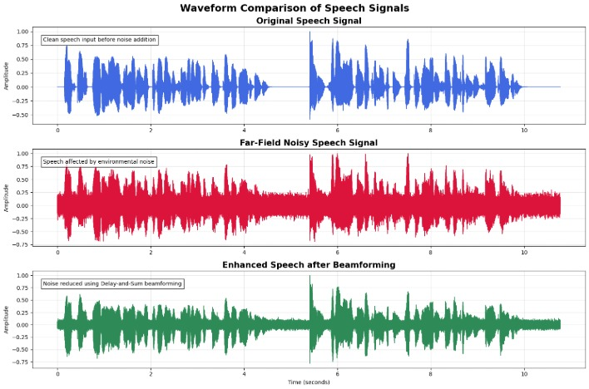
Results and Analysis

Slide 12
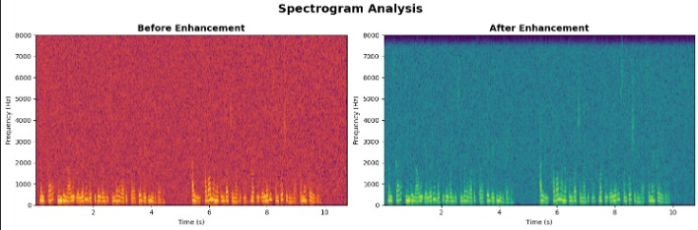
Results and Analysis

Slide 13
Conclusion and Future Scope
A prototype-level far-field speech recognition system was successfully developed using beamforming techniques.
Delay-and-Sum beamforming and preprocessing improved speech quality in noisy environments.
The proposed system successfully demonstrated speech enhancement and ASR integration using Whisper.
The prototype validated the feasibility of beamforming-based far-field speech recognition.
Future work includes implementing real microphone-array hardware for real-time speech acquisition.
Advanced techniques such as MVDR and neural beamforming can be integrated for better performance.
Regional-language ASR accuracy can be improved using larger datasets and optimized models.
The system can be extended into a real-time embedded speech recognition solution for practical applications.

Slide 14
References
[1] W. He, L. Lu, B. Zhang, J. Kalgaonkar and C. Fuegen, “Spatial Attention for Far-Field Speech Recognition with Deep Beamforming Neural Networks,” in ICASSP, 2020.
[2] W. Zhang, A. S. Subramanian, X. Chang, S. Watanabe and Y. Qian, “End-to-End Far-Field Speech Recognition with Unified Dereverberation and Beamforming,” in Interspeech, 2020.
[3] K. Kumatani, M. Wu, S. Sundaram, N. Strom and B. Hoffmeister, “Multi-Geometry Spatial Acoustic Modeling for Distant Speech Recognition,” in ICASSP, 2019.
[4] D. Wang, Z. Chen and T. Yoshioka, “Neural Speech Separation Using Spatially Distributed Microphones,” IEEE/ACM Transactions on Audio, Speech and Language Processing, vol. 28, pp. 715–726, 2020.
[5] T. Yoshioka and M. Delcroix, “Neural Network Based Beamforming for Far-Field Speech Recognition,” IEEE Signal Processing Letters, vol. 24, no. 6, pp. 855–859, 2017.
[6] J. Chen, J. Benesty and Y. Huang, “Microphone Array Signal Processing for Speech Enhancement,” IEEE Signal Processing Magazine, vol. 23, no. 5, pp. 26–34, 2006.

Slide 15
Thank You

